Slide 2



Programmer and Debugger for ESP32
Realized by:
Mohamed GUENI
Notes:
Gentlemen , members of the jury and both my academic and industrial supervisor . I’d like to thank you all for being present today to evaluate my work . First let me present myself : I am Mohamed Gueni , industrial electronics engineering student at the national engineering school of sousse. Before diving into the details of my graduation project entitled programmer and debugger for esp32. we’l go through the overview .

Slide 3
Overview
Problematic
Solution
Hardware design Flow
Software Development
Perspective & Outlook
Notes:
Throughout the presentation we’ll start by posing the problematic next we’ll go through both hardware and software solutions eventually we will get to the perspective and outlook.

Slide 4
Problematic

Slide 5
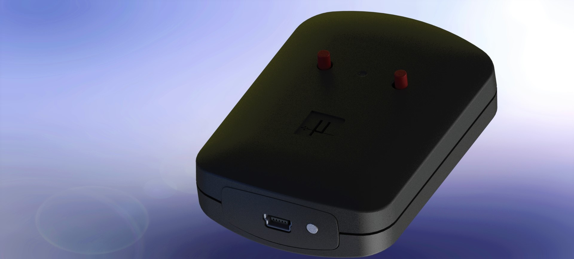
PROBLEM STATEMENT/IDEA
WORKING SYSTEM
Notes:
The problem statement set by this project is the absence of an industrial environment oriented solution allowing us to conduct programming and debugging procedures for the esp32 family .
Setting the problem statement clear now we can go from just an idea to a fully working system .

Slide 6
2. Solution
Hardware design Flow
Notes:
To do so , we needed some methodology to work with .
For that reason we followed a specific hardware design flow .
A hardware design flow is nothing but a rough guide or steps that we needed to follow to tur our main idea into a fully functional system.

Slide 7
HARDWARE DESIGN FLOW
BRAINSTORM
EVALUATE
DESIGN
(TOP LEVEL)
SCHEMATIC CAPTURE
PCB LAYOUT
Notes:
This one is a very simplified version of the hardware design flow
It has five stages to convert a concept into a functional system

Slide 8
PROBLEM STATEMENT
BRAINSTORM
EVALUATE
DESIGN
(TOP LEVEL)
SCHEMATIC CAPTURE
PCB LAYOUT
Notes:
At first we had a problem statement in had which we already mentioned earlier
This represents an input to the brainstorming phase

Slide 9
PROBLEM STATEMENT
BRAINSTORM
EVALUATE
DESIGN
(TOP LEVEL)
SCHEMATIC CAPTURE
PCB LAYOUT
DESIGN CONCEPT
Notes:
The objective here is to generate as many concepts as possible

Slide 10
PROBLEM STATEMENT
BRAINSTORM
EVALUATE
DESIGN
(TOP LEVEL)
SCHEMATIC CAPTURE
PCB LAYOUT
DESIGN CONCEPT
Notes:
These concepts are evaluated in the next stage using the requirements and constraints metrics which addresses the important details that our system must satisfy

Slide 11
PROBLEM STATEMENT
REQUIREMENTS & CONSTRAINTS
BRAINSTORM
EVALUATE
DESIGN
(TOP LEVEL)
SCHEMATIC CAPTURE
PCB LAYOUT
DESIGN CONCEPT
Notes:
There may be situations where things could boil down to nothing
In that case we could always go back and reconsider things

Slide 12
PROBLEM STATEMENT
REQUIREMENTS & CONSTRAINTS
BRAINSTORM
EVALUATE
DESIGN
(TOP LEVEL)
SCHEMATIC CAPTURE
PCB LAYOUT
DESIGN CONCEPT
SELECTED CONCEPT
Notes:
Meanwhile , the selected concept is translated into a block diagram which is then broken down into components and schematic sheets under the boundaries of requirements and constraints .

Slide 13
PROBLEM STATEMENT
REQUIREMENTS & CONSTRAINTS
BRAINSTORM
EVALUATE
DESIGN
(TOP LEVEL)
SCHEMATIC CAPTURE
PCB LAYOUT
DESIGN CONCEPT
SELECTED CONCEPT
Notes:
The design stage will produce the system architecture

Slide 14
PROBLEM STATEMENT
REQUIREMENTS & CONSTRAINTS
BRAINSTORM
EVALUATE
DESIGN
(TOP LEVEL)
SCHEMATIC CAPTURE
PCB LAYOUT
DESIGN CONCEPT
SELECTED CONCEPT
SYSTEM ARCHITECTURE,BLOC DIAGRAM
Notes:
Again , in some cases we may end up going nowhere
So we might need to reconsider going back to fix things

Slide 15
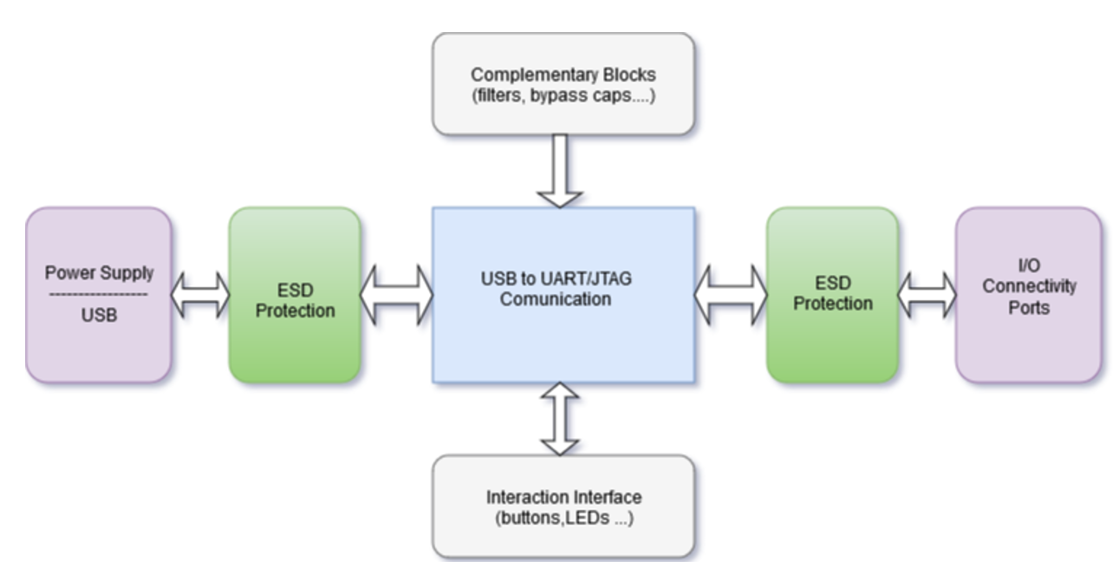
SYSTEM ARCHITECTURE
Notes:
This right here is our system architecture
It has 6 major building blocks

Slide 16
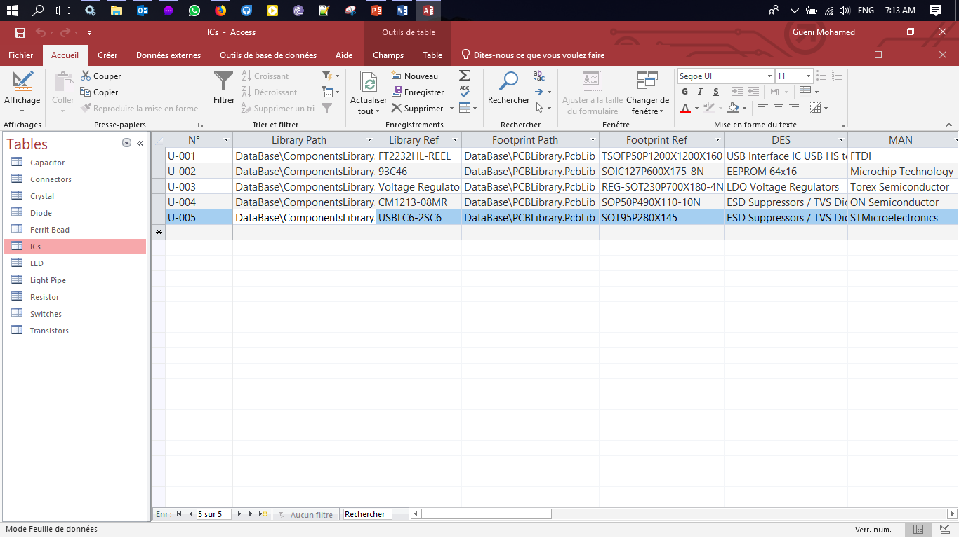
COMPONENTS DATABASE

Slide 17
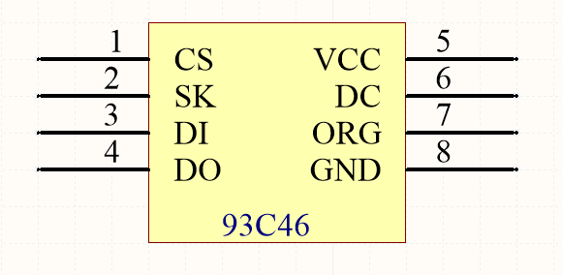
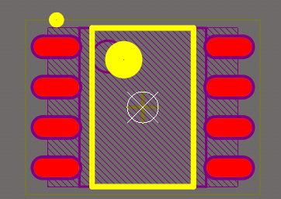
SYMBOL
FOOTPRINT

Slide 18
PROBLEM STATEMENT
REQUIREMENTS & CONSTRAINTS
STANDARDS ,REFERENCE DESIGNS
BRAINSTORM
EVALUATE
DESIGN
(TOP LEVEL)
SCHEMATIC CAPTURE
PCB LAYOUT
DESIGN CONCEPT
SELECTED CONCEPT
SYSTEM ARCHITECTURE,BLOC DIAGRAM
SCHEMATIC,
NETLIST, BOM
Notes:
This system architecture which is currently in the form of blocks is translated into logical circuit schematics
The standards and reference design act as a guideline in the process of creating the circuit

Slide 19
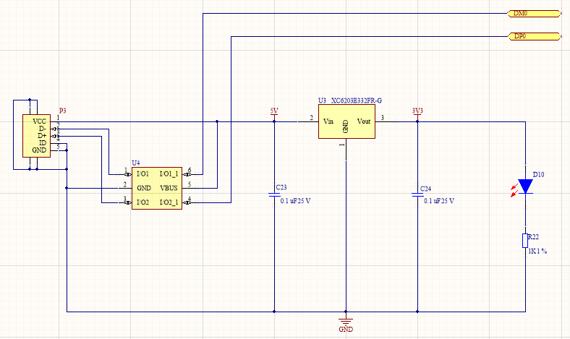
USB and Power Connector circuit schematic

Slide 20
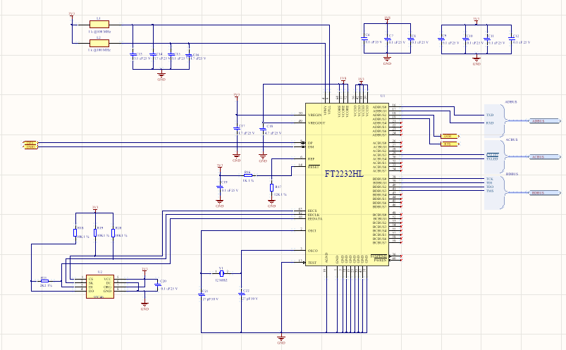
FT2232 USB to UART/JTAG Circuit schematic

Slide 21
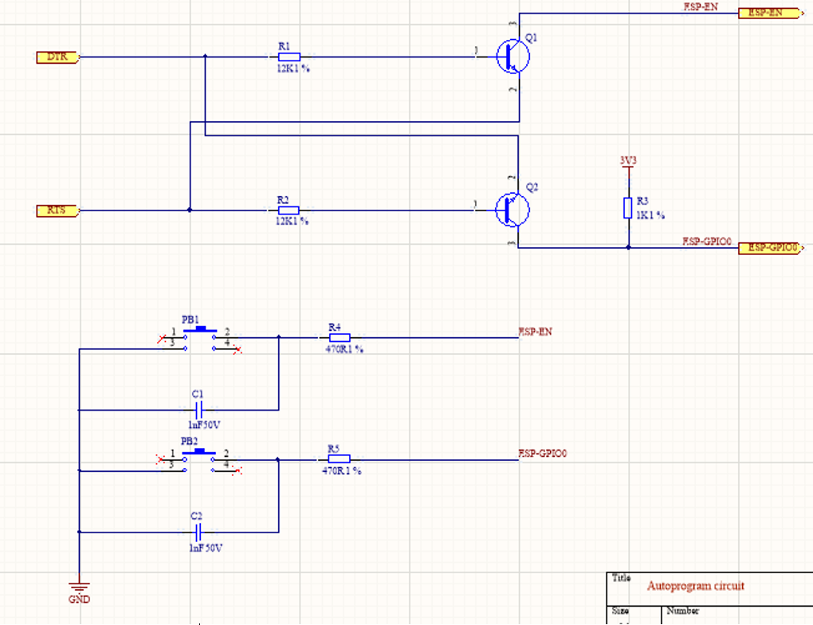
Auto program circuit schematic

Slide 22
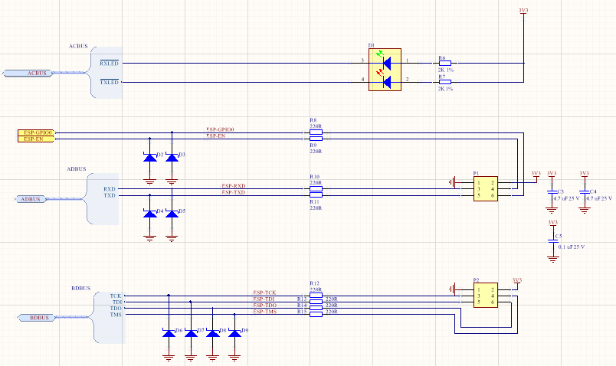
Input/output Connectors Circuit schematic

Slide 23
PROBLEM STATEMENT
REQUIREMENTS & CONSTRAINTS
STANDARDS ,REFERENCE DESIGNS
BRAINSTORM
EVALUATE
DESIGN
(TOP LEVEL)
SCHEMATIC CAPTURE
PCB LAYOUT
DESIGN CONCEPT
SELECTED CONCEPT
SYSTEM ARCHITECTURE,BLOC DIAGRAM
SCHEMATIC, NETLIST, BOM
Notes:
This stage will produce different design documents such as schematic and BOM files
Now these design documents are used in the next stage and transformed into files that are required for pcb manufacturing

Slide 24
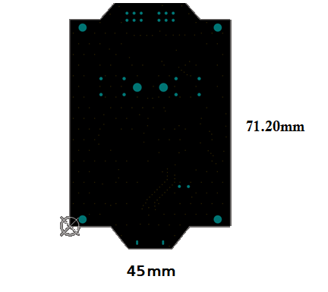
PCB layout was tailored according to the enclosure dimensions .
Light pipes and Mounting holes’ drills were fixated to be in harmony with the design and reduce error margin.

Slide 25
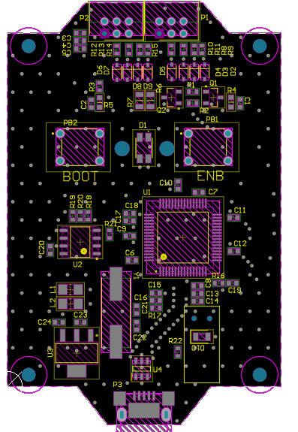
Mechanical Constraints.
Symmetry and precision.
Grouping Parts to Minimize Connection Paths.

Slide 26
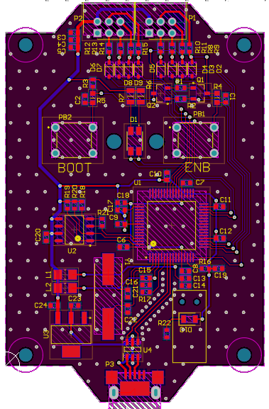
Fixate all requirement on minimum trace width 0.3mm, spacing (clearance 0.2mm) and the number of layers (2 layers) etc.…
45-degree angle traces.
continuous ground plane on both layers of the PCB

Slide 27
PROBLEM STATEMENT
REQUIREMENTS & CONSTRAINTS
STANDARDS ,REFERENCE DESIGNS
STANDARDS , CONSTRAINTS
BRAINSTORM
EVALUATE
DESIGN
(TOP LEVEL)
SCHEMATIC CAPTURE
PCB LAYOUT
DESIGN CONCEPT
SELECTED CONCEPT
SYSTEM ARCHITECTURE,BLOC DIAGRAM
SCHEMATIC
NETLIST, BOM
PCB FILES , MANUFACTURIG DATA
Notes:
The output of this stage is pcb layout files and all other files required for manufacturing

Slide 28
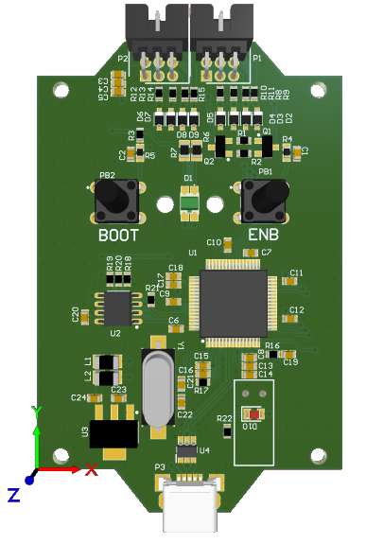
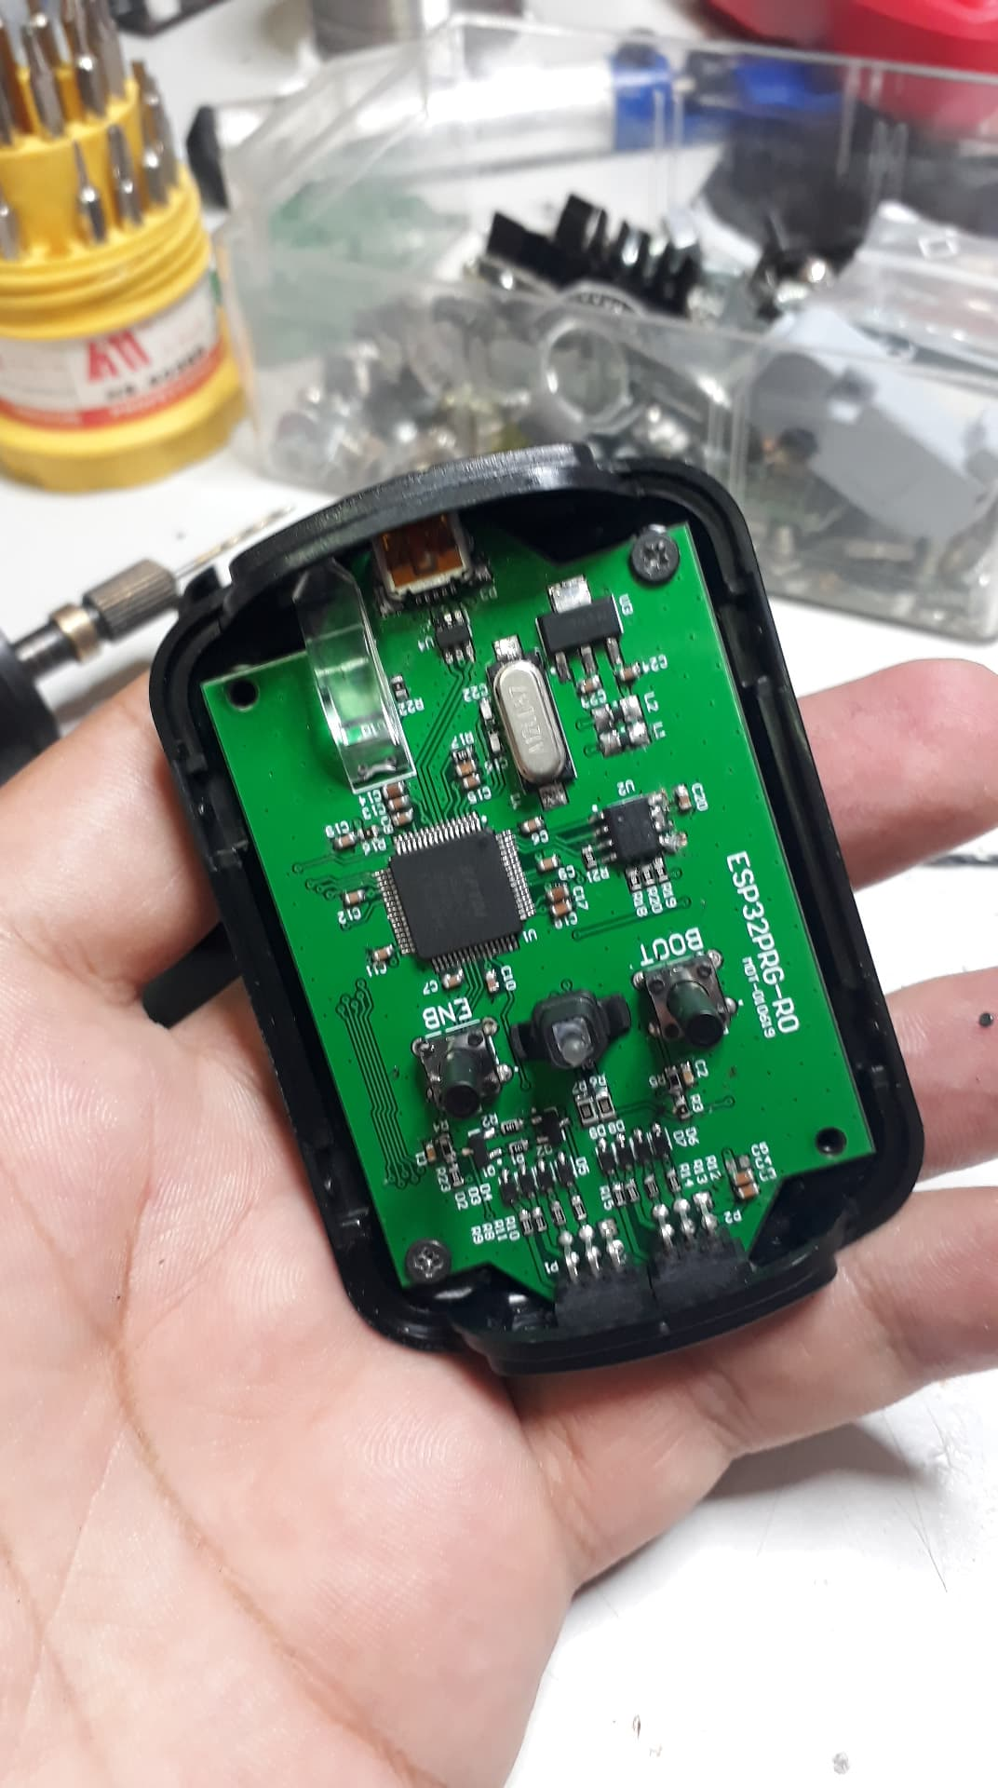
Designed PCB
Working Prototype

Slide 29
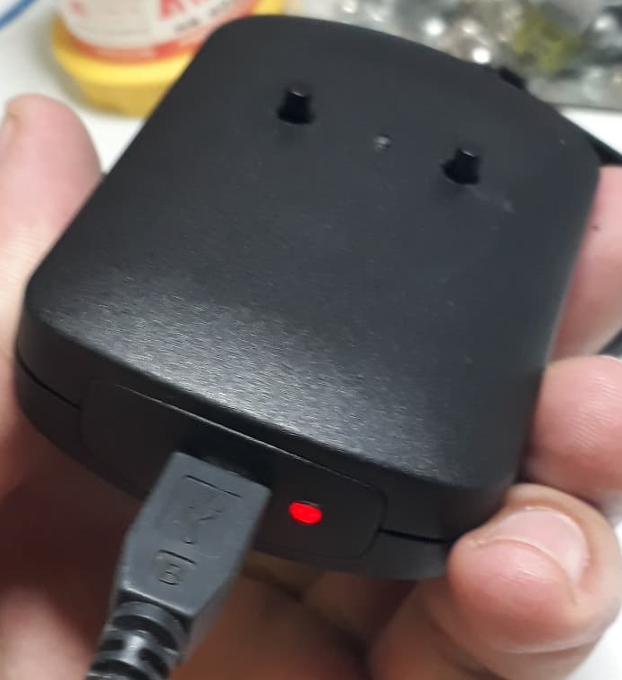

Slide 30
PROBLEM STATEMENT
REQUIREMENTS & CONSTRAINTS
STANDARDS ,REFERENCE DESIGNS
STANDARDS , CONSTRAINTS
BRAINSTORM
EVALUATE
DESIGN
(TOP LEVEL)
SCHEMATIC CAPTURE
PCB LAYOUT
DESIGN CONCEPT
SELECTED CONCEPT
SYSTEM ARCHITECTURE,BLOC DIAGRAM
SCHEMATIC
NETLIST, BOM
PCB FILES , MANUFACTURIG DATA
Notes:
Again we could go back in case we needed to

Slide 31
Software Development

Slide 32

Python as our programming language
extensive support for open source libraries
fast speed
easy readability and organization of the code
PyQt, which is a Python binding of the famous cross-platform GUI toolkit Qt.

Slide 33
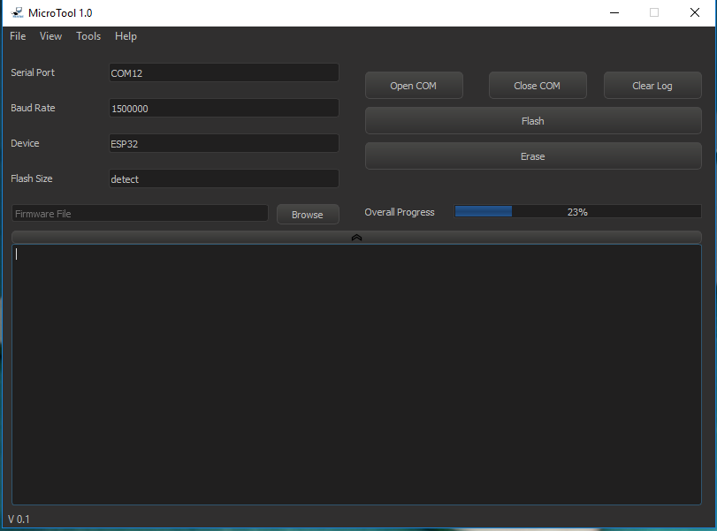
Production Mode
Designed to be simple used by operators in production departments.
Contains only Basic and necessary Features such as Flashing a binary firmware file or erase the flash memory.

Slide 34
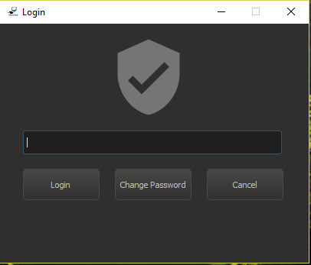
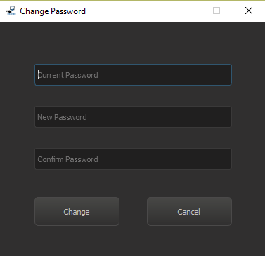
A login to limit the use of the advanced mode to an expert so that no ordinary operator would tamper with the firmware files or any kind of configuration made available by this software.
Password changing procedure where the inputs get loaded into an SQLite database to override the previous password.

Slide 35
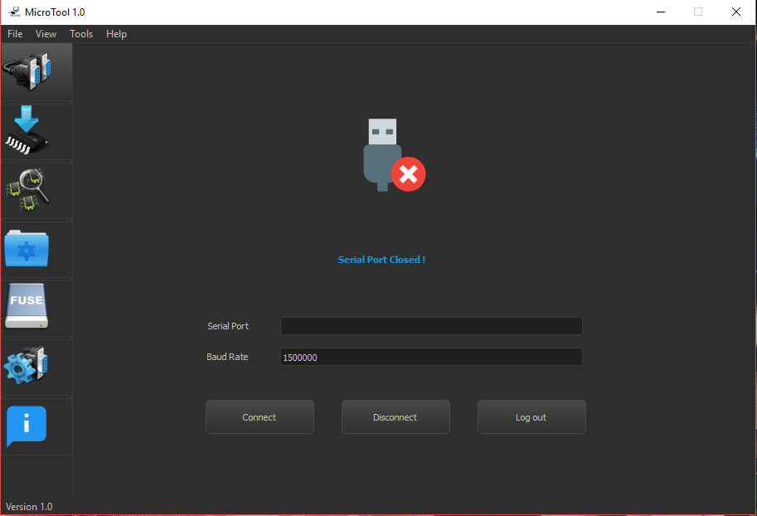
ADVANCED MODE
Gives the user the ability to:
Connect
Disconnect from target device
Log back out to the production mode.
Select Baud Rate.

Slide 36
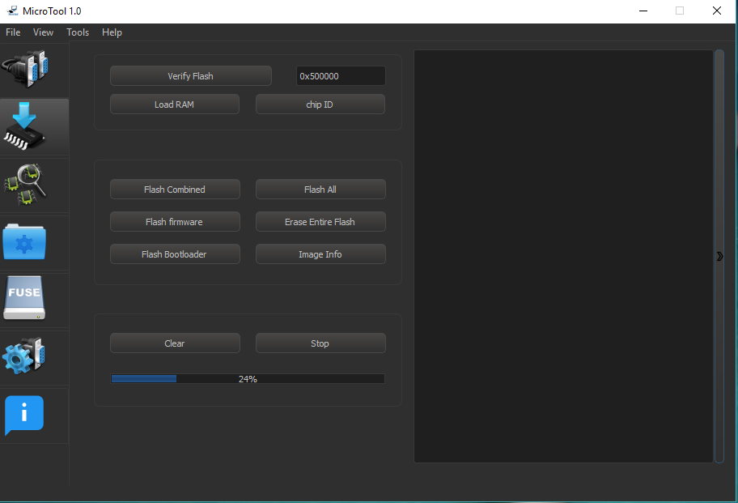
All major actions needed to:
flash either firmware, bootloader and partition table or all at the same time.
Check Image information.
Erase Entire Flash Memory….

Slide 37
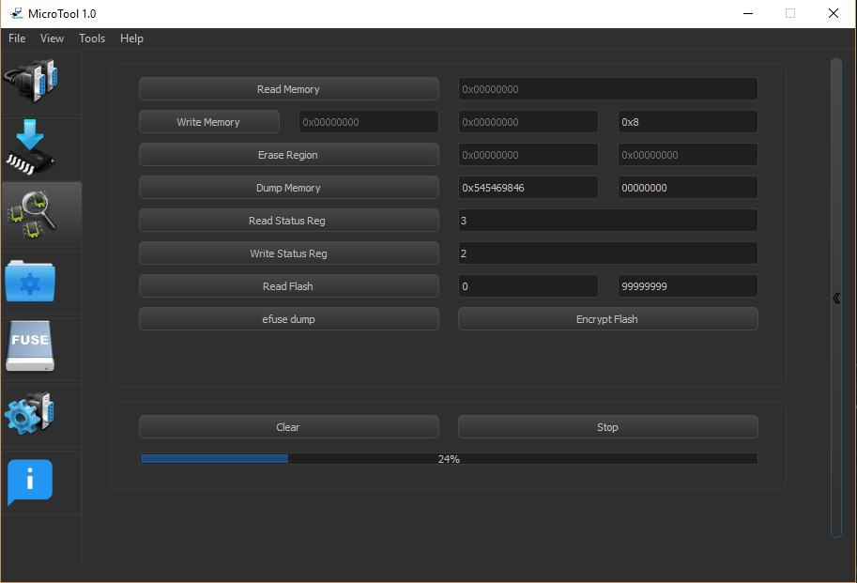
Functionalities related to memory management:
Read & Write Memory
Erase Region
Dump Memory
Efuse Dump …

Slide 38
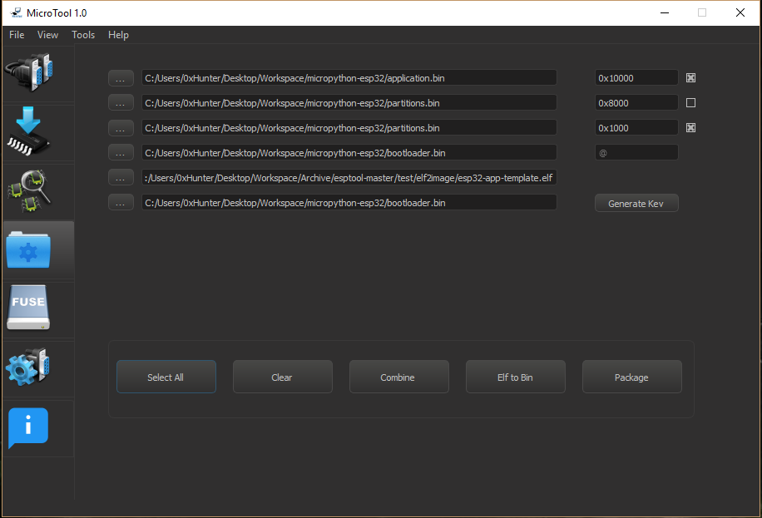
file management functionalities:
combines all selected binary images
creates a new package with the extension “.mdt”
converts an elf file to a bin image
to generate the flash encryption key.

Slide 39
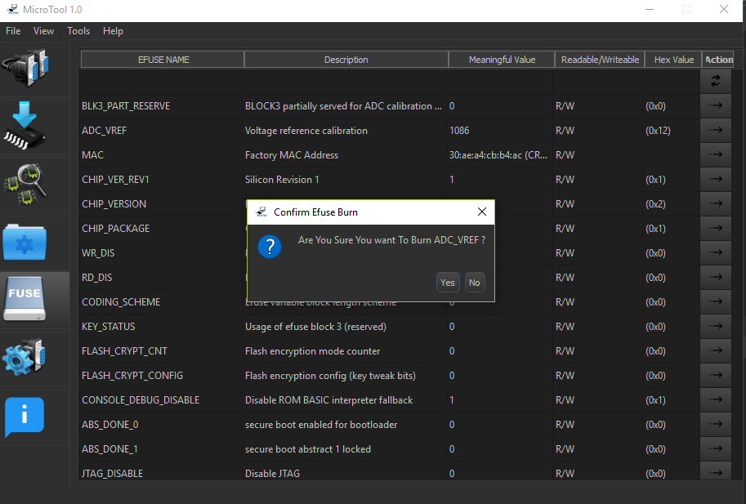
Loads the chip’s Efuse registers in a clean and organized disposition
Set of buttons to allow the user to select and burn any Efuse of the loaded list.

Slide 40
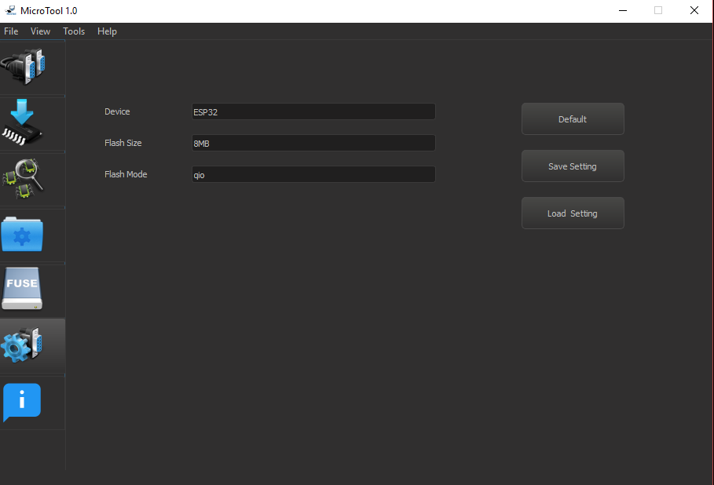
The necessary configurations before moving to the flashing phase:
Flash Size
Flash Mode…

Slide 41
3. Perspective & Outlook
Limiting the file type used by the software to only those generated by the packaging functionality.
Customizing the software to only connect to our Hardware.

Slide 42
Thank you for Your Attention

